Slide 1

ALY 3510 AI Foundations:
An Interdisciplinary Approach
Week 3:
Feedback
Session/Section: Fall 2026
Instructor: Vladimir Shapiro

Slide 2

Feedback - Week 2
Reflection Journal
Going well
  Good combination of authentic thinking and research by some
  Good grasp of the Symbolic/Rule-based AI
  Nice projection of the concept to relevant industries
  Good understanding of the challenges
  Sharing useful videos is welcome

Slide 3
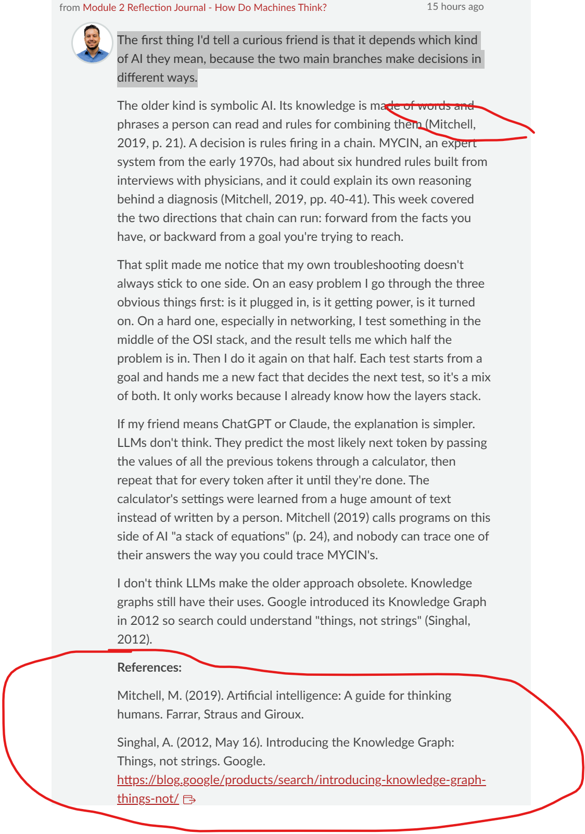
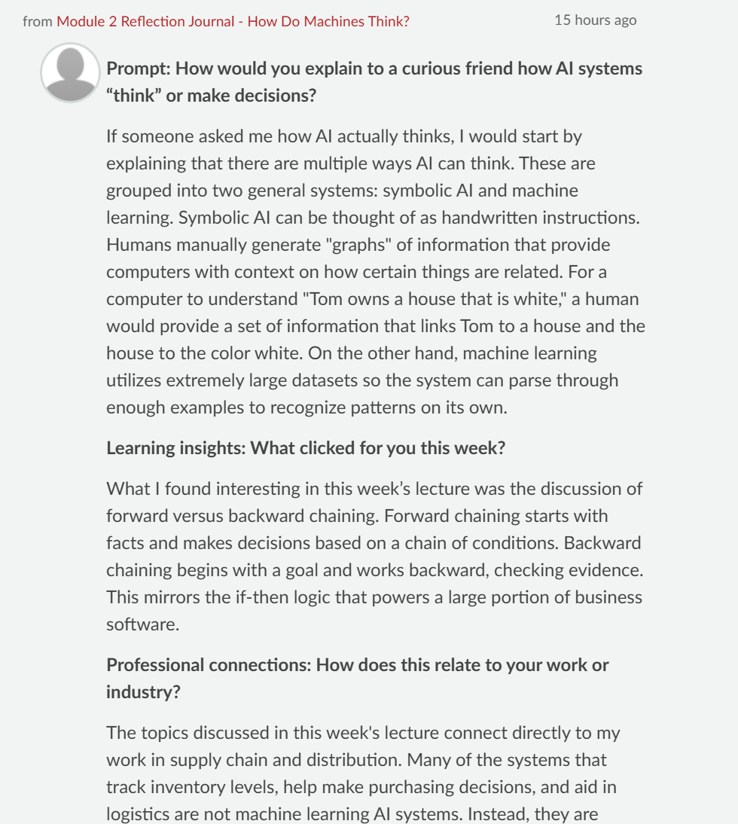
Feedback - Week 2
Reflection Journal
Going well
  Good formatting (Nathaniel, Tyrie, Dan, Luizza) – APA, formatting, sections, headings in boldface

Slide 4
Feedback - Week 2
Reflection Journal
To improve
  The vast majority defined AI as "pattern recognition", "model training", " neural networks". I admire their seeing the future …☺, but this is not how Symbolic AI works…
  Explaining to a non-technical friend is a challenge. Cannot use sophisticated technical terminology…
  Visuals could be helpful.
  It would be nice to link the reflections to the previous lecture and the material we studied earlier.
  Splitting a huge chunk of text into meaningful paragraphs helps readers comprehend the material.
  Backing up your reflections with external sources would be beneficial.

Slide 5
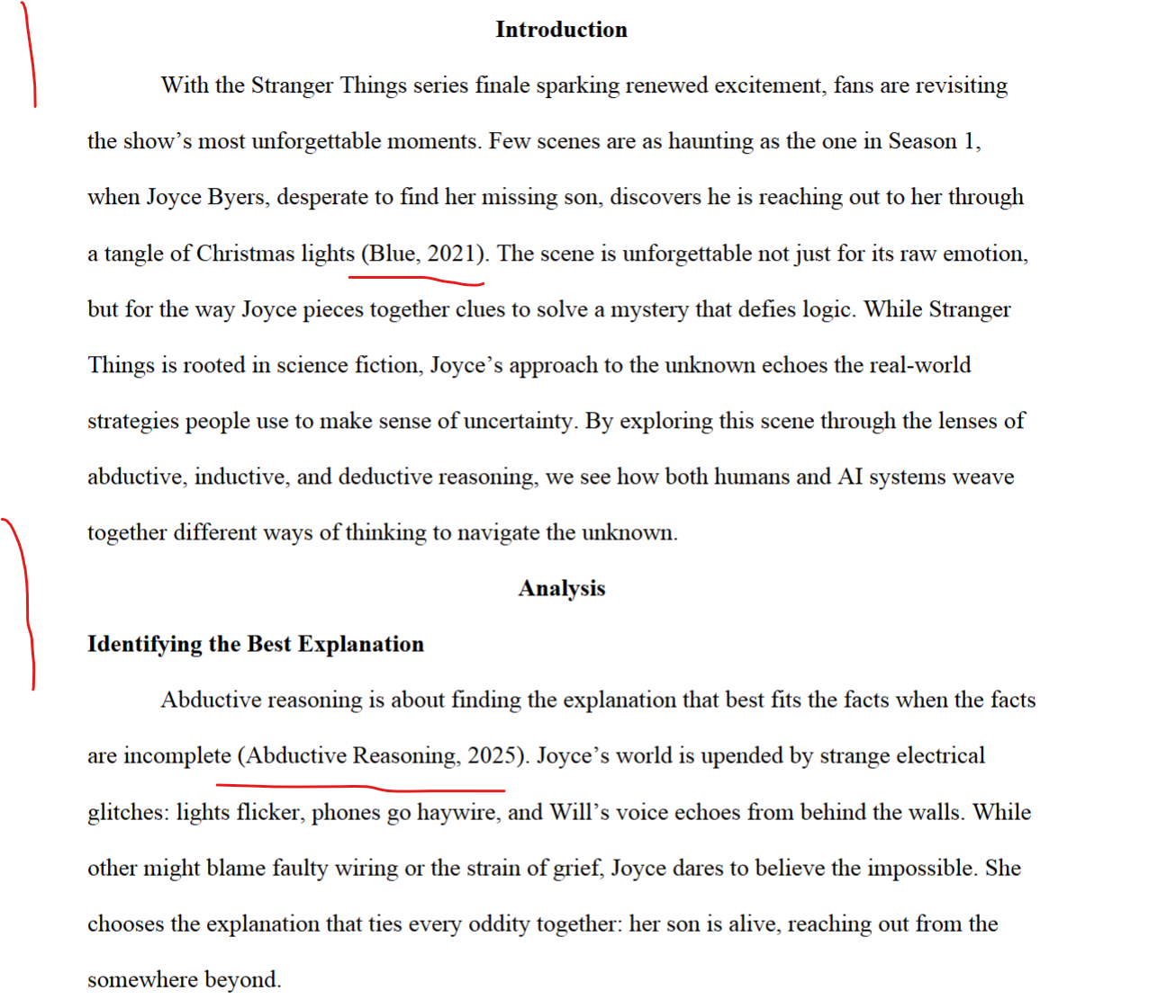
Feedback - Week 2
Assignment
Going well:
  Reasoning logic types seem to be well understood.
  Some original examples (e.g., “Stranger Things”, “Dune” movies).
  Some attempted to combine various types of reasoning.
  Personal view is appreciated
  APA style: Brandon, Max, others ->

Slide 6
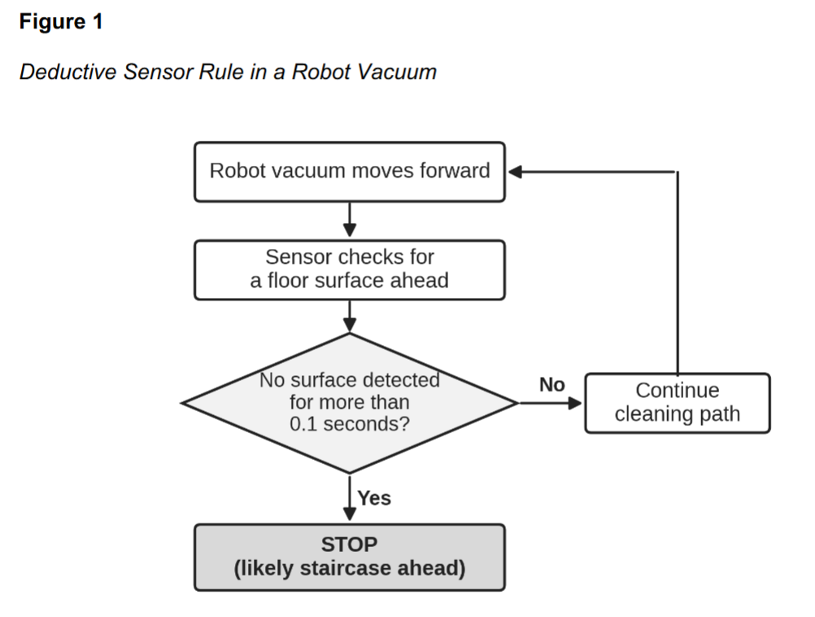
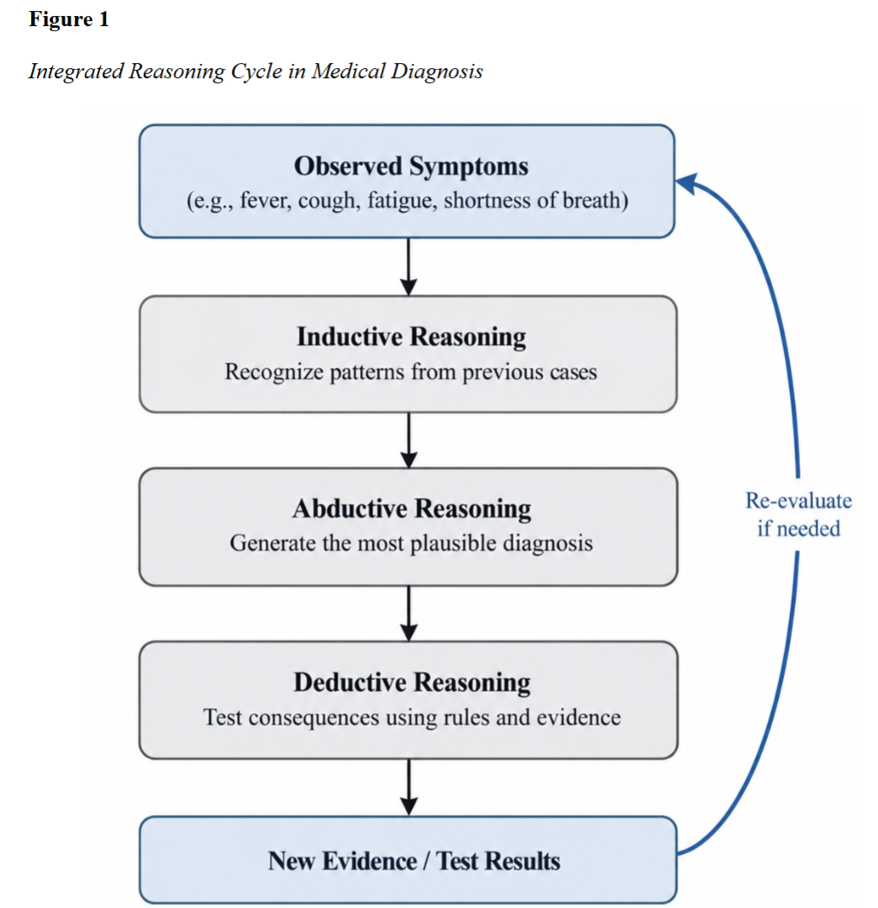
Feedback - Week 2
Assignment
Going well:
  Using visuals (Nathaniel, Dan, Luizza, Lichan, Qiantao):

Slide 7
Feedback - Week 2
Assignment
To improve – formal matters
  Late/Missing submissions
  The assignment solution should follow this structure: Title Page, Introduction, Body/Analysis (where the solution should go), Conclusions, and References.
  The requirement was to use the numbers above in your answers (i.e., A1, A2, etc.). It applies to A1a, A1b, etc.
  It was requested that the questions/tasks be repeated “verbatim” in full.
  All figure/table captions, references, and citations at the sentence level must follow the APA format.
  Visuals would be welcome.

Slide 8
Feedback - Week 2
Quiz
Late/Missing submissions
Primarily high-grades
Any issues or concerns?

